Slide 1



MeriSkill Ist pj
View in Power BI
Last data refresh:
9/20/2023 10:11:46 AM UTC
Downloaded at:
9/20/2023 10:19:23 AM UTC

Slide 2
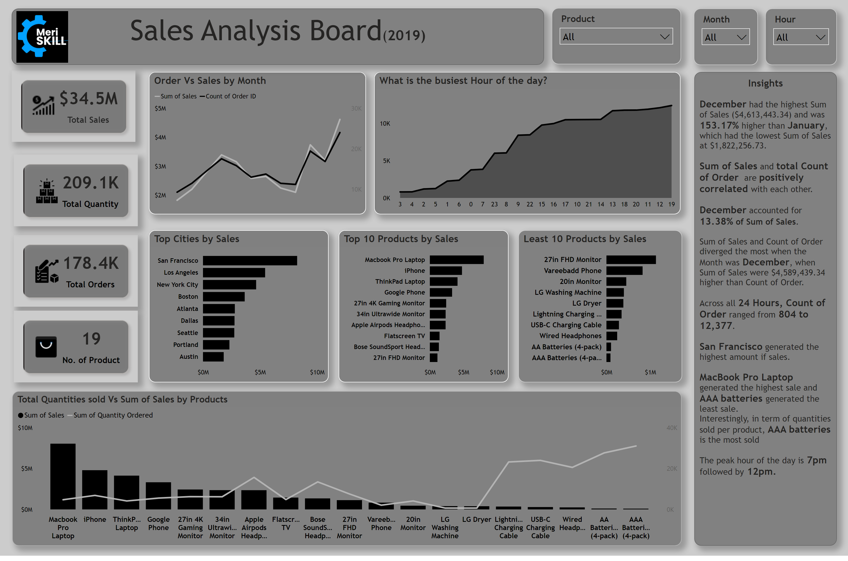
Duplicate of Page 1
Notes:
Top 10 Products by Sales
No alt text provided
cardVisual
No alt text provided
cardVisual
No alt text provided
cardVisual
No alt text provided
cardVisual
No alt text provided
slicer
No alt text provided
slicer
Mnth
slicer
No alt text provided
Top Cities by Sales
No alt text provided
What is the busiest Hour of the day?
No alt text provided
Order Vs Sales by Month
No alt text provided
textbox
No alt text provided
textbox
No alt text provided
Least 10 Products by Sales
No alt text provided
Total Quantities sold Vs Sum of Sales by Products
No alt text provided
image
No alt text provided

